Slide 1

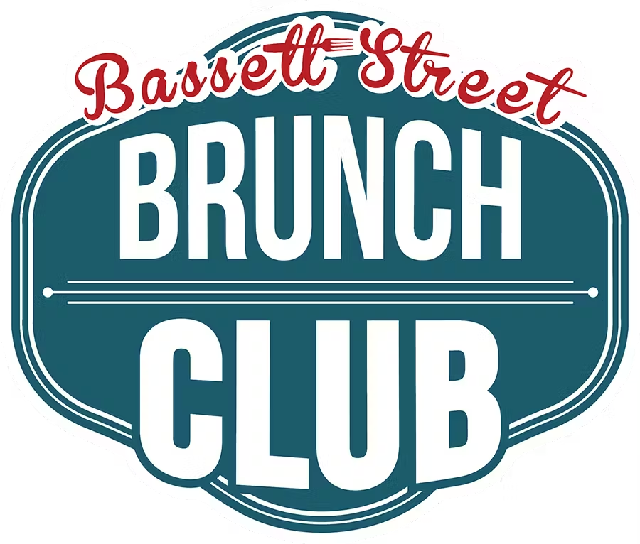
Bassett Street Brunch Club
Emma Reisman, Anna Wozniak, Greer Diaz, Madeline Krentzman, Maeve Dillon, Taylor Boxer
Group 8
Notes:
"Hello everyone, today we will be discussing our research project for Bassett Street Brunch Club"

Slide 2
Introduction and Problem Definition
BSBC
Intro & Problem
Notes:
"Now let's begin with our introduction and problem definition phase"

Slide 3
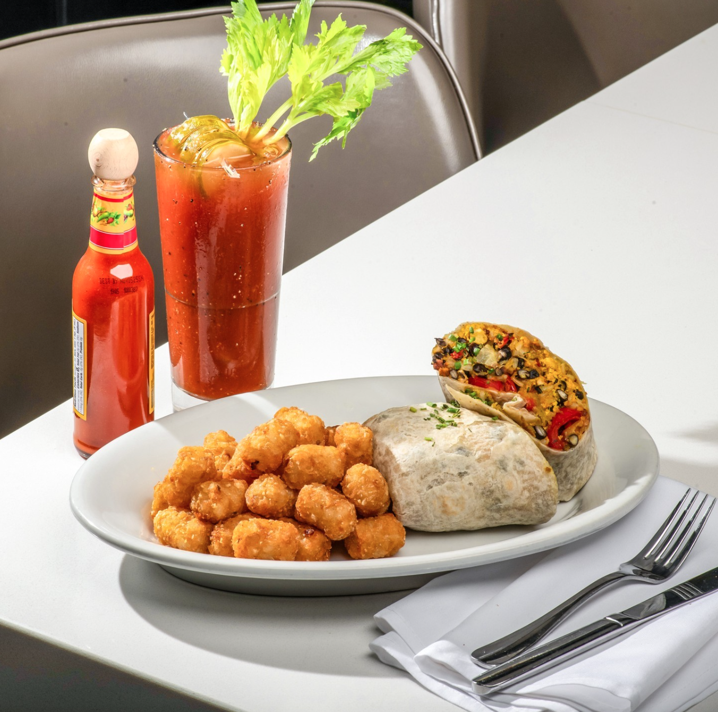
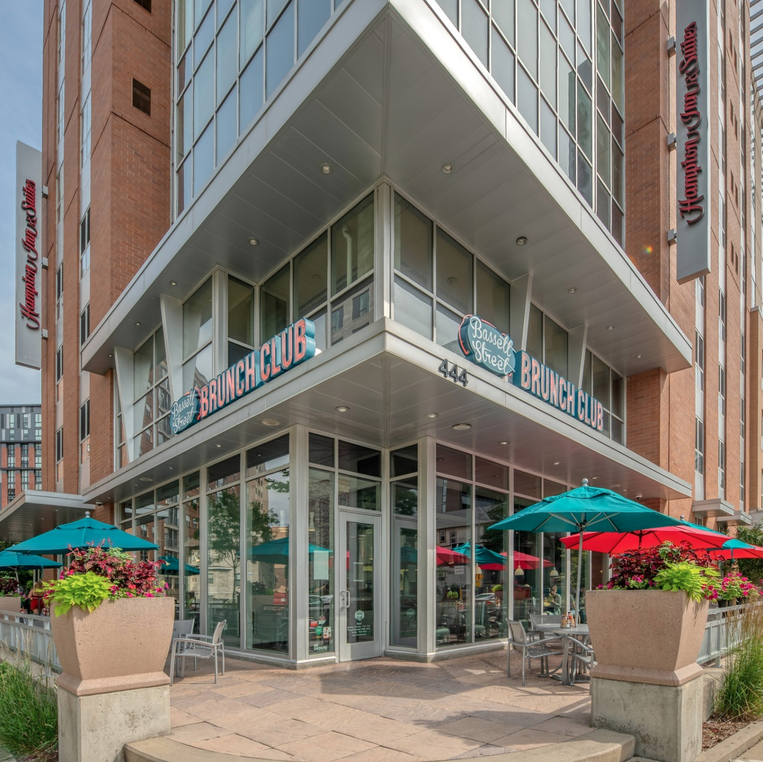
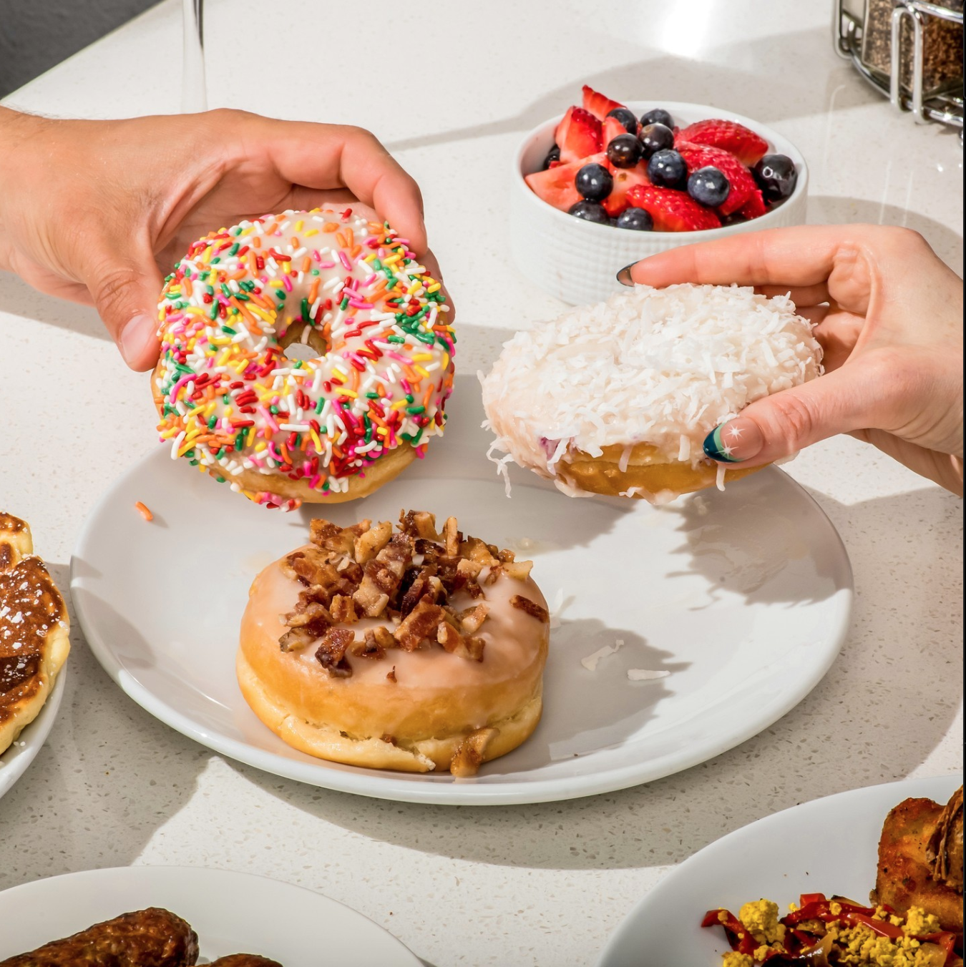
Background
BSBC
Intro & Problem
Notes:
Emma
“Bassett Street Brunch club is a well-known brunch restaurant in the heart of Madison, WI. Located close to campus on West Johnson Street inside of the Hampton Inn and Suites hotel. Bassett is known for their busy peak times, hearty brunch foods, and donuts. Bassett is one of the only spots that is a full-service restaurant, compared to other brunch locations that are counter service. Their target population is students, hotel guests, and student's parents.”
(About 22 seconds)

Slide 4
Decision Problem
BSBC
Intro & Problem
What can be done to make Bassett stand out from other brunch restaurants in Madison?
Notes:
Emma
“For our project, we wanted to investigate what can be done to make Bassett stand out from other brunch restaurants in Madison.”
(About 5 seconds)

Slide 5
Research Statements
BSBC
Intro & Problem
Investigate overall customer satisfaction (food, service, price, vibe, etc.) and target market perceptions of Bassett.
Determine target market dietary preferences
Investigate consumer’s perspectives on competitors’ pricing and menu offerings
Identify emerging food, drink, and restaurant trends that are popular amongst our target market to update the menu.
Evaluate customer feedback on service speed and wait times to identify areas of improvement.
Notes:
Emma
“Our research statements investigate overall customer satisfaction, target market dietary preferences, consumers perspectives on competitors pricing and menu, emerging food, drink, and restaurant trends, and customer feedback on service speed and wait times.”
(About 12 seconds)

Slide 6
Methodology and Findings
BSBC
Method & Findings
Notes:
"Next, we will discuss our methodology and findings"

Slide 7
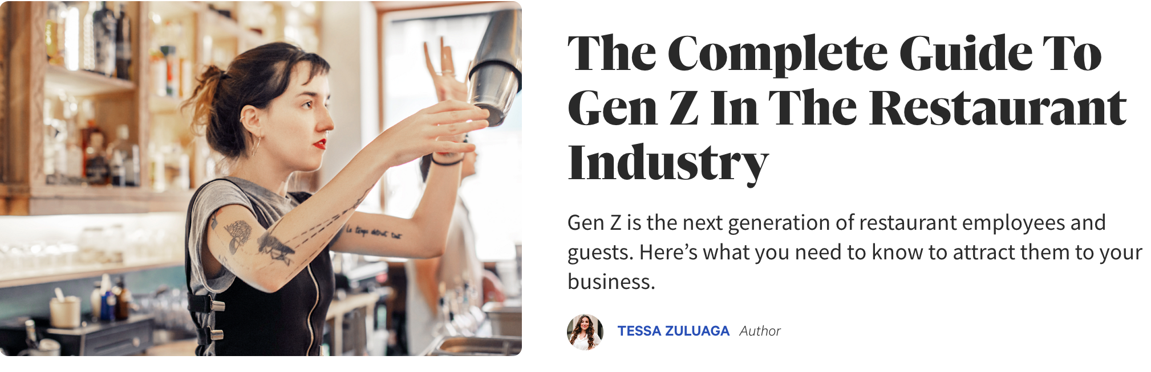
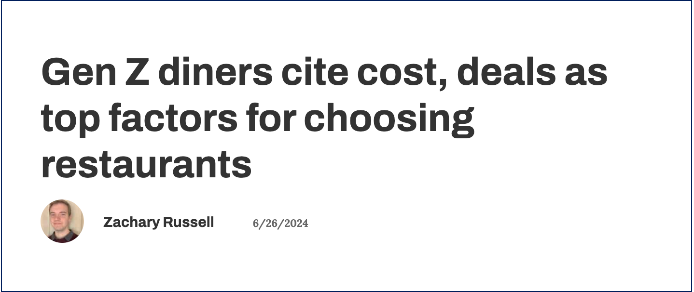
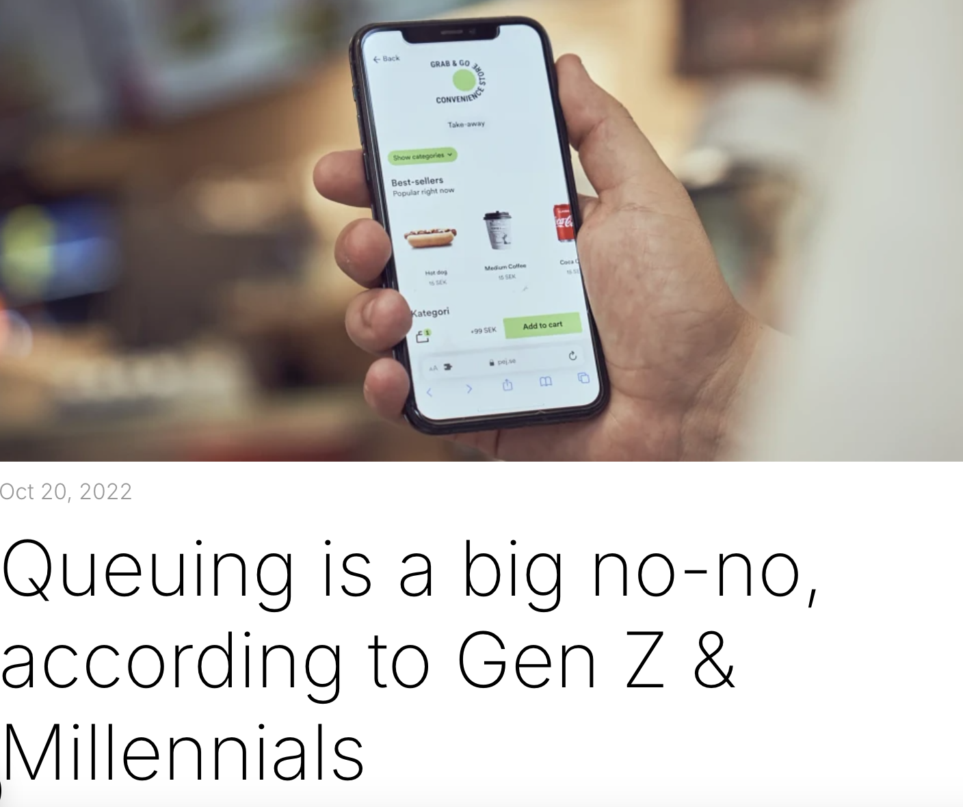
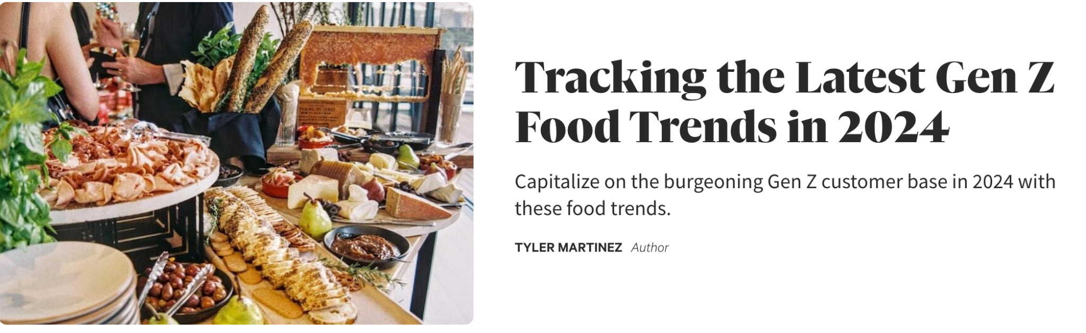
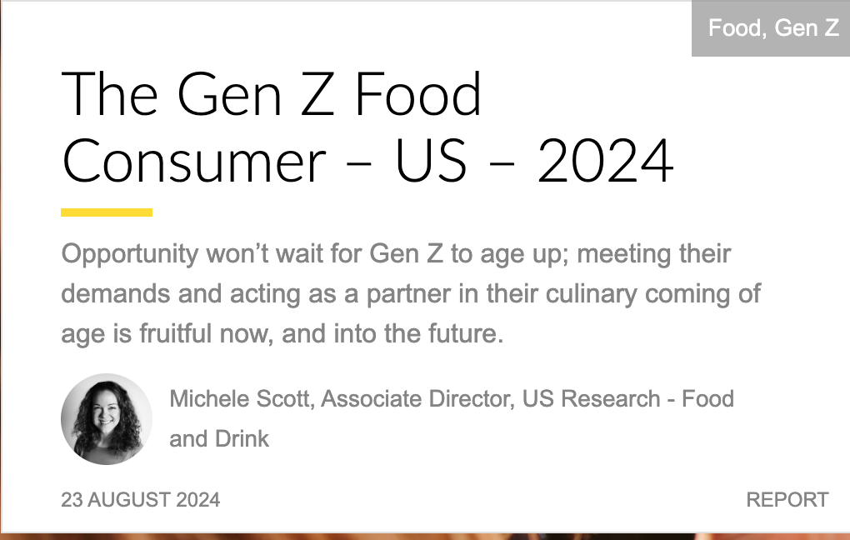
Secondary Research
BSBC
Method & Findings
Notes:
Emma
“During our decision problem phase, we conducted a literature search to inform decision-making. We looked at 5 sources. Our findings concluded that our target market values eating out for the social interaction and view restaurants as a third space for spending time with friends. Additionally, these consumers are looking for healthier dishes with better ingredients, and emphasize the importance of convenience. For restaurants to succeed, they must craft a unique and memorable atmosphere, offer a variety of health menu items, and create a seamless dining experience.
(About 25 seconds)

Slide 8
Qualitative Research: Employee Focus Group
BSBC
Method & Findings
Dairy-free milk and gluten-free options are most requested
Many customers are dissatisfied with wait times
kjk
Breakfast food is favored regardless of time of day
Notes:
Qualitative Research
Methodology
We decided to conduct both depth interviews and a focus group for our qualitative research. We recognized the importance of gathering insights from both customers and employees to capture perspectives from both sides, and we determined it would be most effective to assign the focus group to BSBC employees and the in-depth interviews to customers. We believed employees would feel more comfortable sharing their opinions about the workplace in a group setting, where they could discuss common experiences more freely.
Focus Group Findings
During the focus group, we discovered that they feel BSBC stands out as one of the few full-service sit-down brunch restaurants. Also from the focus group, employees mentioned that the Bassett Street Brunch Club’s menu accommodates a variety of dietary preferences and restrictions. Overall, the focus group findings revealed that dairy-free milk and gluten-free modifications are the most commonly requested by the target market.
Our focus group findings also revealed that, regardless of the time of day, customers tend to favor breakfast items, even when dining during lunch or dinner hours. Traditional breakfast combinations—such as eggs, toast, and breakfast meats—continue to dominate in popularity. However, there is also a noticeable rise in more modern trends, such as breakfast burritos and gourmet breakfast sandwiches, reflecting evolving customer preferences for more creative and hearty breakfast options.
Service speed at BSBC is heavily influenced by how busy the restaurant is. When the restaurant has been full for an extended period, the kitchen can become backed up, causing wait times for food that can be longer than usual. Servers try to manage customer expectations by informing tables at the beginning of the experience that the kitchen is backed up and, in turn, the food may take longer. College students, familiar with Bassett, generally expect long waits, while hotel guests and parents are more often surprised. They expressed a wish that customers would plan and put their names down earlier to avoid being caught off guard by the wait times.

Slide 9
Qualitative Research: Customer Depth Interviews
BSBC
Method & Findings
kjk
Service speed & quality is great, but long wait times
Overall satisfied, still room for improvement
Prices reflect the value and portions of food
Enjoy hearty portions but want more healthy options
More seasonal specials and cultural dishes
Notes:
Interview findings
We interviewed 6 customers at Basset. Most agree that the menu has good options for lots of different diners, the consensus tends to be that traditional brunch options could be added. Pricing is generally seen as fair and on par with other brunch places, and the atmosphere received varying opinions. Despite the long wait times, the service is consistent and reliable. Overall, our interviewees felt that Bassett was just “okay” and while they have had good experiences, there is room for improvement.
From our interviews, we learned that customers are not entirely dissatisfied with Bassett’s current menu selection, however they would prefer healthier options to be added. They felt that while Bassett Street does provide hearty, filling brunch options, not everyone dining prefers this type of food. Overall, Bassett is underperforming in dietary options and meal options that its customers want.
The feedback from the interviews reveals that while Bassett's pricing is generally considered fair and on par with local competitors. Compared to Madison's competitors like Short Stack Eatery and Vintage, Basset's portion sizes and food quality are viewed as better.
A common theme among all the interviews was the highlighting of several suggestions for menu updates at Bassett. Customers expressed a desire for more variety and excitement through rotating menu options, seasonal specials, and additional basic favorites. Some interviewees suggested incorporating more international or cultural dishes to move beyond traditional American breakfasts.
Based on the results from all of the interviews, Basset’s service is praised for being quick, friendly, and attentive once customers are seated for their meal. However, consistently long wait times, usually well over an hour, are a major deterrent for customers. In addition, with other brunch restaurant options in Madison, Bassett is usually not at the top of customers' wish list of places.

Slide 10
Questionnaire
BSBC
Method & Findings
4 Filter questions at the start to segment target audience
Funnel approach to guide respondents from broad to detailed
Around 2-4 questions per research statement
Close-ended questions with “N/A” options to reduce response bias
Notes:
Questionnaire
Methodology
Questions 1-4 are filter questions that segment our target audience.
As mentioned in the beginning, our questionnaire follows a funnel approach, in which respondents go from broad to specific questions.
We included 2-4 survey questions that would help us answer our research statements. This allows us to gather the most comprehensive and valuable information from our respondents, also keeping the data aligned with our decision problem.
All of our questions, except for questions 11 and 13, are close-ended. Respondents may feel pressured to pick an option that doesn’t fully reflect their views, introducing response bias. To mitigate this, we included “does not apply” or “I don’t remember” as an option for some questions (Q9, Q11, Q12).

Slide 11
Survey Method
Survey Attributes
BSBC
Method & Findings
Online survey
Ease of sampling based on University tools
Lower total response rate
Cost effective, easy, flexible
Convenient: digitally engaged population
Notes:
We believe that completing an online survey is the preferred method for getting information from our target population. Using the school directory is an efficient way to approach students and will work effectively with an online method. Our target population is already digitally engaged so this method is one that fits into their current lifestyle, providing the flexibility that college students need. With online surveys, we do expect lower response rates, however, due to their flexible, easy, and cost effective nature, we believe that this method is still the most effective.

Slide 12
Sampling
BSBC
Method & Findings
Probability sample increased levels of specificity, confidence
Stratified sampling approach: analyzing pieces of subgroups
Consider size with 3 key attributes
Notes:
In a probability sample, each individual in the population has a known chance of being selected, means that results are general to the entire population. Since it is more specific, we can calculate sampling error and confidence intervals while reducing selection bias. Since a non-probability sample works better for exploratory research, our group believes that a probability sampling method will provide the best results.
While there are 3 main sampling methods avaliable, we believe that a stratified sample is the best approach. This method divides the population into subgroups based on shared characteristics, with random samples taken from each group, enabling detailed subgroup analysis. This method allows us to divide our population to target each research statement. For example, research statement 1, which investigates overall customer satisfaction, would be best targetted with stratified sampling since we can divide customers into groups like frequent, occasional, and rare customers. Therefore, allowing us to understand a representative groups of all sections of the population.
We can consider sample size based on 3 characteristics. First, we must determine how homogenous the population is. With a more similar population, we can contact fewer people because opinions and beliefs are shared more frequently. Second, we must look inward to determine how much precision is necessary. Increasing our sample size allows for more precision and increased accuracy since we will receive a larger range of responses. Increasing size also reduces the margin of error. Lastly, we must consider the level of confidence needed to understand if the true value falls within the range established. Higher confidence intervals require larger sample sizes. Therefore, a sample can be determined by evaluating homogeneity, precision, and confidence level.

Slide 13
Important Results and Conclusions
BSBC
Results & Conclusions
Notes:
“Next were going to discuss our important results and conclusions from our data”

Slide 14
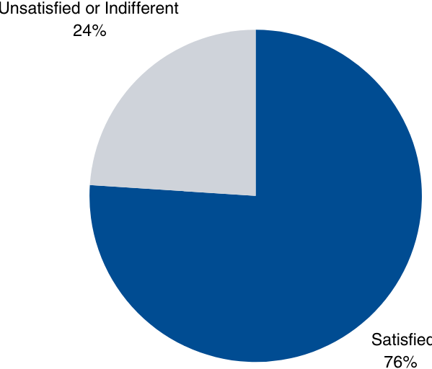
Overall Satisfaction
Important Results and Conclusions
BSBC
Results & Conclusions
Customers enjoyed…
47% atmosphere/vibe
30% enjoyed food
9% enjoyed service speed
4% enjoyed the price
Research Statement #1:
Investigate overall customer satisfaction (food, service, price, vibe, etc.) and target market perceptions of Bassett.
Notes:
Starting with our first research statement, “Investigate overall customer satisfaction (food, service, price, vibe, etc.) and target market perceptions of Bassett.”
We found The percentage of customers who are satisfied with their overall experience at Bassett Street Brunch Club is 76%, made up of 17 customers (30%) who were somewhat satisfied, and 26 customers (46%) who were extremely satisfied. When asked more specifically what they enjoyed the most, 47% of customers enjoyed the atmosphere/vibe, 30% enjoyed the food, 9% enjoyed the service speed, and 4% enjoyed the price.
After conducting data analysis through SPSS, we found that the average value of satisfaction was 4.09, which corresponds to somewhat satisfied customers. The standard deviation from the mean is a +/- 1.04, meaning that a majority of customers fall between “neither satisfied nor dissatisfied” and “extremely satisfied”, therefore we draw the conclusion that most customers are satisfied with Basset Street Brunch Club.

Slide 15

Dietary Preferences
BSBC
Results & Conclusions
22% of respondents had dietary restrictions
Research Statement #2:
Determine target market dietary preferences
40% (6/13) of allergy respondents with restrictions had nut allergies.
75% of those customers reported it was “very important” that BSBC’s menu options catered to their needs
Notes:
Our second research statement we investigated was, “ Determine target market dietary preferences”
There are more customers without dietary restrictions than with 78% to 22%, respectively. This data is shown by the graph where the orange icons are representative of the sample with dietary restrictions. Within the 22%, 75% of them reported that it was “very important” that Bassett Street Brunch Club’s menu options catered to their needs.
Finally, we found that the most popular dietary restriction or preference were nut allergies at 6 responses and 40% of total responses.

Slide 16
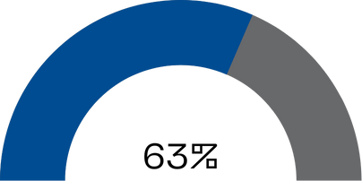

Pricing
BSBC
Results & Conclusions
Menu offerings
3/4 customers said prices are at least a “somewhat important” decision making factor
20% of respondents said the menu could improve with an added egg dish
Research Statement #3:
Investigate consumer’s perspectives on competitors’ pricing and menu offerings
Graph: BSBC’s prices are comparable to competitors (38 respondents)
38% of respondents said nothing was missing from the menu
Notes:
Our third research statement we researched was, “Investigate consumer’s perspectives on competitors’ pricing and menu offerings.”
Based on our survey responses we’ve concluded that Bassett Street Brunch Club is competitive and reasonable in their pricing when compared to other brunch spots in Madison and when related to the proportion of food Bassett Street Serves. We found 75% or 3/4ths of customers said prices are at least “somewhat important” when choosing brunch restaurants, as Gen Z is becoming increasingly price conscious.
About 63% of respondents claim Bassett Street Brunch Club’s prices are comparable to other restaurants and 29% said they had higher prices.
We also looked at menu offerings, as they are very important to consumers when selecting a restaurant. 62% of respondents said the menu could improve in some way and when asked what dish was missing from BSBC’s menu 20% responded with adding a new egg dish like an omelet, skillet, or taco.
However, 38% of respondents said nothing was missing from the menu. From this data, Bassett Street Brunch Club seems to be reasonable and comparable in its pricing.

Slide 17
Emerging trends
BSBC
Results & Conclusions
Research Statement #4:
Identify emerging food, drink, and restaurant trends that are popular amongst our target market to update the menu.
49% of respondents were interested in protein-packed dishes
However 32/60 respondents said lowering wait times were a better area for improvement than adding another menu item
93% of respondents are likely to try a new item aligning with a food trend
Notes:
Our fourth research statement was, “Identify emerging food, drink, and restaurant trends that are popular amongst our target market to update the menu.”
Staying up to date with food trends and preferences could attract new customers to Bassett Street Brunch Club. 49% of respondents were interested in protein-packed dishes compared to other trends which show an emerging trend of ingredient-conscious consumers who want satiating, nutritious food. 93% of respondents are likely to try a new menu item aligning with food trend meaning if consumers followed what they reported, Bassett Street Brunch Club could see increasing profits from switching up the menu from time to time. Based on our last cross tab 32 customers said that lowering wait times was more important than adjusting for dietary restrictions.

Slide 18
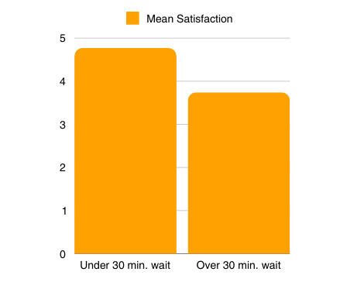
Service speed
BSBC
Results & Conclusions
Our independent sample t-test
Research Statement #5:
Evaluate customer feedback on service speed and wait times to identify areas of improvement.
48% of respondents said that service speed was fast and 42% said it was acceptable.
4.77 3.74
63% said that they waited over 30 minutes to dine
link between greater satisfaction and lower wait time
Notes:
Our last research statement, #5 was, “ Evaluate customer feedback on service speed and wait times to identify areas of improvement.”
48% of respondents said that the overall service speed was fast and 42% said it was acceptable, meaning Bassett Street Brunch Club is an above-average restaurant for time from ordering to food on the table speed. In regard to waiting for a table 63% of people waited more than 30 minutes to dine at BSBC.
A wait longer than 30 minutes deducted customers overall satisfaction, After conducting an independent sample t-test for means for satisfaction rating, we found that the mean satisfaction rating for customers who waited less than 30 minutes for a table was 4.77, and the mean satisfaction rating for customers who waited 30-90 minutes was 3.74. This means customers who wait a shorter period of time for a table are more satisfied with their experience at BSBC.

Slide 19
Recommendations
BSBC
Recommendations
Notes:
Next, we will dive into our recommendations for Bassett Street Brunch Club.

Slide 20
“The Basics” Subsection
Recommendations: Menu Changes
BSBC
Recommendations
“Protein Power” Subsection
Highlight nutritional value to appeal to fitness-focused customers with high -protein options
Long time trend and here to stay
Egg whites, turkey sausage, veggies, steak, chicken
Simple, affordable dishes like plain omelets, breakfast skillets, and tacos are preferred
Lower price point to attract price sensitive consumers
Customizable
Notes:
Based on the results of our questionnaire, we recommend that Bassett Street Brunch Club (BSBC) introduce two new menu subsections.
The first subsection, "The Basics," can feature simple and affordable egg-based dishes, such as plain omelets with customizable add-ins, classic breakfast skillets, and straightforward breakfast tacos. These options will cater to diners seeking uncomplicated menu items at a lower price point, making them ideal for budget-conscious customers. We also recommend that these types of plates be customizable to cater to differing diet preferences, such as gluten-free or allergies.
The second subsection, "Protein Power," should highlight high-protein dishes, including protein-packed omelets and frittatas made with egg whites, lean meats, and vegetables. Emphasizing the nutritional value of these dishes can attract health-conscious and fitness-focused diners, while also expanding the menu’s selection of nutrient-dense options. This is a trend that has been around for years and is here to stay, and therefore we think it is worthwhile.

Slide 21
Weekday Specials
Improving Wait Times
Recommendations: Specials and Wait Times
BSBC
Recommendations
Implement a reservation system to manage customer flow and reduce wait times.
Benefits: Efficient table turnover and preparation and improved customer satisfaction and repeat visits.
Offer discounts for students with ID.
Promote specials on social media and through UW-Madison-targeted ads.
Notes:
Additionally, our survey results suggest implementing weekday specials to attract Wisconsin students during off-peak times. While brunch is popular on weekends, none of the respondents indicated a likelihood of dining at a brunch spot on a weekday. To address this, we propose offering weekday student discounts for lunch, such as reduced pricing for those who present a student ID. To maximize awareness, BSBC should promote these specials on digital platforms, including social media, and run targeted ads for UW-Madison students.
Finally, over half of respondents identified long wait times as the primary area for improvement. To address this, we recommend introducing a reservation system. This would allow BSBC to better anticipate customer volume, optimize table usage for quicker turnover, and provide diners with the assurance of a reserved table. We anticipate that a reservation system will enhance the overall dining experience, improve customer satisfaction, and encourage repeat visits.
By adopting these recommendations, BSBC can attract a broader audience and significantly enhance customer satisfaction.

Slide 22
Research Limitations
BSBC
Limitations
Notes:
Although we produced valid and reliable results, there are still a few limitations to our research.

Slide 23
Time Constraint
Only one semester
BSBS
Limitations
Longer project timeline → more detailed and accurate results
Notes:
One of these limitations was time. Given that we only had one semester to conduct our research on Bassett Street Brunch Club, the results are not as in detailed and accurate as they could’ve been if we had more time to conduct our research.

Slide 24
Convenience Sample
Diversity of Respondents
Still Valid Responses
BSBC
Limitations
Mostly friends – women between the ages of 20-22
Not representative of all BSBC customers
Only used responses that passed the filtering questions
Notes:
In addition, we used a convenience sampling approach and urged friends to take our survey. This means that the respondents are likely a majority of women between the ages of 20-22. Given that these respondents still passed the filtering questions, their responses are still valid, but the pool of respondents may not be representative of all bassett street brunch club customers.
Without demographic questions, we cannot be certain who these results are representative of and who ended up answering the survey.

Slide 25
References
BSBC
References

Slide 26
BSBC
References
Martinez, Tyler. “Tracking the Latest Gen Z Food Trends in 2024.” Toast, 2024, https://pos.toasttab.com/blog/on-the-line/gen-z-food-trends-and-statistics. Accessed 6 October 2024.
Pej. “Queuing is a big no-no, according to Gen Z & Millennials.” Pej, 20 October 2022, https://pej.io/blog/queing-is-a-big-nono-according-to-genz-and-millenials. Accessed 6 October 2024.
Russel, Zachary. “Gen Z diners cite cost, deals as top factors for choosing restaurants.” Chain Store Age, 27 June 2024, https://chainstoreage.com/gen-z-diners-cite-cost-deals-top-factors-choosing-restaurants. Accessed 6 October 2024.
Scott, Michelle. “The Gen Z Food Consumer.” Mintel, 23 August 2024, https://clients-mintel-com.ezproxy.library.wisc.edu/report/the-gen-z-food-consumer-us-2024?fromSearch=%3Ffilters.category%3D21%26filters.consumer-segment%3D15%26last_filter%3Dcategory%26resultPosition%3D1. Accessed 6 October 2024.
Smucker Co., JM. “Generation Z Breakfast Trends - Smucker Away From Home.” Smucker Away From Home, https://www.smuckerawayfromhome.com/resources/trends/Generation-Z-Breakfast-Brief. Accessed 6 October 2024.
Zuluaga, Tessa. “The Complete Guide To Gen Z In The Restaurant Industry.” Toast, 2024, https://pos.toasttab.com/blog/on-the-line/gen-z-restaurant-guide. Accessed 6 October 2024.

